Slide 1
WELCOME TO HIGH SCHOOL Inspiring all learners to reach their highest potential as responsible, productive citizens.
8th Grade
student Meeting

Slide 2
Welcome Parents & OCSA Students!
Goals for Today:
Introduce Counselor team
Diploma options
Graduation Requirements
GPA CALCULATION
Parent portal login
College & Career
Academic Programs (AP, de, cte)
9th grade Sample schedules
Clubs
New Student tips

Slide 3
Counseling Department
Mr. Arrington- School Counselor for Band, Orchestra, and Vocal
Ms. Karaki- School Counselor for Creative Writing, Drama, Visual Arts, Dance, and Technical Theater
Mrs. Gill- College and Career Counselor
Mrs. Frederick- School Social Worker
Ms. Lashley- School Psychologist
Mrs. Millan - Guidance Secretary and Registrar
Mrs. Roldan- Data Entry Clerk and Attendance Clerk

Slide 4
What We Do
Help students with social/emotional issues
Help students with academic issues
Assist students with post-secondary plans, college admissions process and scholarships/financial aid.
Serve as a link between parents, teachers, students, and administration
Help with testing
Make sure all students are ready to receive a high school diploma
Assist with career exploration

Slide 5
Art Area Specifics
At OCSA, every year, students will have at least two art area classes.
Common Freshman Art Area Classes Are:
Band: Symphonic Band and Music Theory 1
Orchestra: String Techniques and Opus Orchestra
Vocal: Mixed Choir and Music Theory 1
Creative Writing: Creative Writing 1 and 2 and Journalism 1
Visual Art: Drawing and 2D Studio Art
Drama: Acting 1 and Theater 1
Technical Theater: Costume Design and Stagecraft 1
Dance: Usually 1 ballet class and 1 modern dance class

Slide 6
Wednesday Events
On Wednesday from 2-3pm, we have special classes or events
First Wednesday of the Month- Master Classes
Second Wednesday of the Month- Social and Emotional learning/Character Education Classes
Third Wednesday of the Month- Academic Enrichment
Fourth Wednesday of the Month- Recital in the Theater
Recital is when the students perform for each other on the stage. Parents are welcome to attend on these days.

Slide 7
How To See Your Counselor
Please book an online appointment.
Mr. Arrington: calendly.com/arringtc
Ms. Karaki: calendly.com/rkaraki
Mrs. Gill: calendly.com/msgill
Mrs. Frederick: see your counselor first
Under the Guidance link on our school website: ocsa.osceolaschools.net/guidance
Open Counseling every Wednesday during lunch time, students do not need an appointment.
Parent Conferences- Please email teacher first, if a meeting is still needed, please contact the teacher to schedule the meeting. Parent conferences are 1-1:30pm.
Please make sure you come with a pass from your teacher unless you booked online.

Slide 8
Diploma options
24-credit option
Scholar
Merit
AP Capstone

Slide 9
GRADUATION REQUIREMENTS
24 Credits
2.0 GPA
1 online course completion
Level 3 or higher in the 10th grade Reading FSA
Level 3 or higher in the Algebra 1 EOC exam
*Other Important Tests
Geometry, Biology, US History EOC = 30% of overall grade

Slide 10
Credit Breakdown
MATH (4 Credits)
Algebra I
Geometry
2 additional Math credits
SCIENCE (3 Credits)
Biology
2 additional Science credits
SOCIAL STUDIES (3 Credits)
World History
US History
Government & Econ. w/ Fin. Lit
ENGLISH (4 Credits)
4.0 English
PHYSICAL ED. (PE) (1 Credit)
HOPE or
Personal Fitness & 1 other PE class
PERFORMING ARTS (1 Credit)
ELECTIVES (8 Credits)
2 credits in the same world language are required for admission into state universities (Not High School Graduation)
ONLINE CLASS

Slide 11
Community Service Hours
Community Service is not a requirement for graduation, however, it is a requirement for the Bright Futures Scholarship.
75 Hours for the Medallion (middle scholarship) and 100 hours for the Academic (top scholarship)
A proposal sheet must be completed before the hours are done, the hours must be approved in advance by the counselor
The hours must be logged on the log form and a reflection must be written on the reflection form
Community service can be started during the summer between 8th and 9th grades.

Slide 12
Diploma Designations
Scholar- In addition to meeting the 24 credit graduation requirements, students must do the following:
Earn Algebra 2 credit
Pass Geometry, Biology, and US History EOC’s
Earn 1 credit in statistics or an equally rigorous math course
Earn 1 credit in chemistry or physics
Earn 1 credit in a science course that is equally rigorous
Earn 2 credits in the same world language
Earn 1 credit in an AP, IB, AICE, or DE course

Slide 13
Diploma Designations
Merit- In addition to meeting the 24 credit graduation requirements, students must do the following:
Attain one or more industry certifications
A student can earn both scholar and merit diplomas

Slide 14
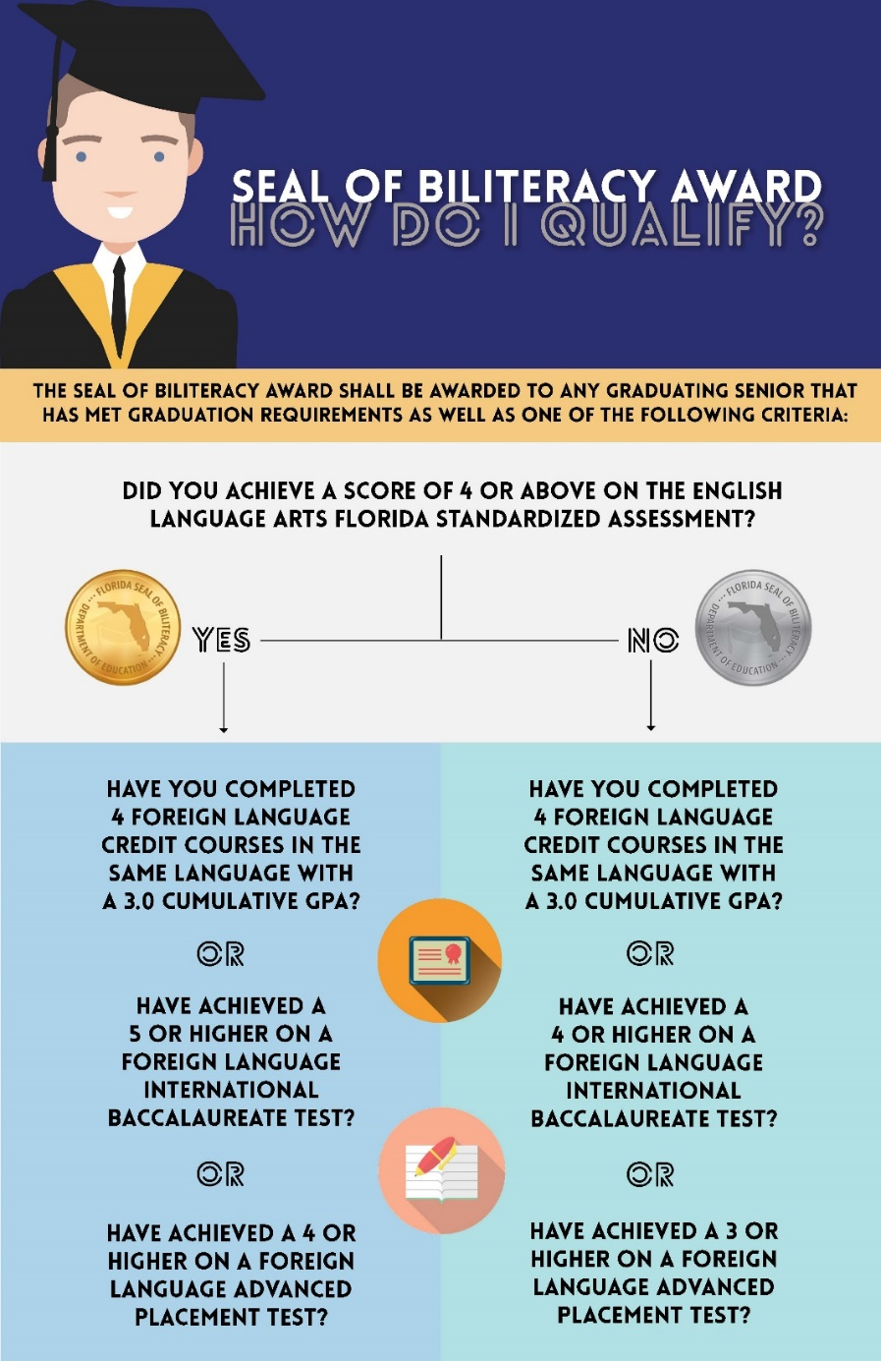

Slide 15
Gpa calculation
Unweighted GPA Points
A=4.0 points
B= 3.0 points
C=2.0 points
D=1.0 points
F=0 points
Weighted GPA
Honors is .5 point weight
A=4.5 points
B= 3.5 points
C=2.5 points
D=1.5 points
F=0 points
Weighted GPA
AP/IB/DE is 1 point weight
A=5 points
B= 4 points
C=3 points
D=2 points
F=0 points
If you made all C’s in every class you took this would give you a 2.0 Unweighted GPA which is what is required for graduation.

Slide 16
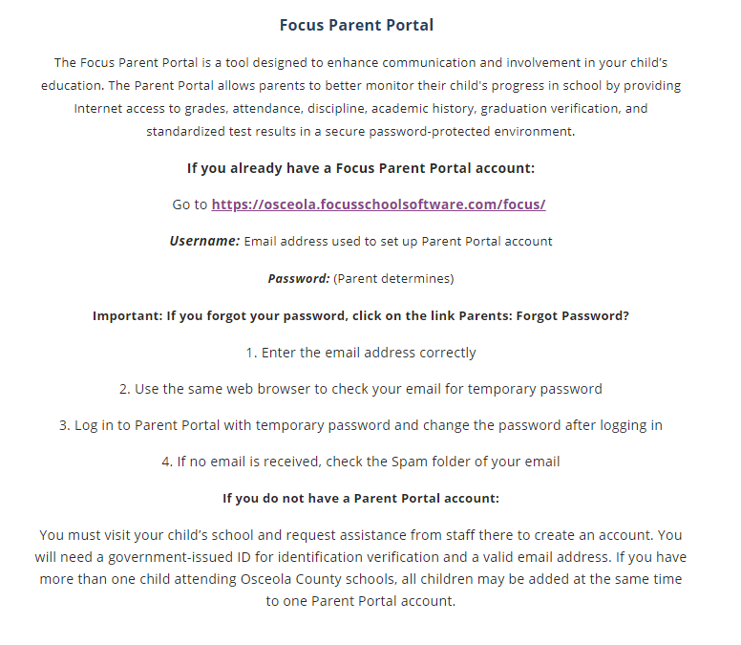
Focus parent portal
Go to School District of Osceola County Website
Click on Parents Tab at the top
Scroll down to “Focus Parent Portal”
If you have an account
If you need to reset password
WE are here to help if you need to create a Parent Portal

Slide 17
Benefits of the parent portal
Attendance information
Access to Grades
Check for any Missing Assignments
Upcoming due dates for tests and assignments
Teacher emails

Slide 18
Post secondary plans
Every student should have a post-secondary plan before they graduate.
College, Technical School, Military or the Workforce
Testing offered in school:
PSAT (Practice SAT)- 9, 10, and 11
SAT/ACT (College Entrance Exam)- 11, 12
PERT (DE placement exam)- As needed

Slide 19
What is Xello?
College and Career Exploration program
Planning for the future
Opportunity for reflection
Learning Style
Interest Profile
Goal Setting
One-stop Guidance Resource
Request transcripts for colleges
Scholarship resource
Xello is accessible through Classlink

Slide 20
ACADEMIC PROGRAMS

Slide 21
ADVANCED PLACEMENT (AP)
CollegeBoard Accelerated program
College level courses and rigor
Earn college credit by passing test at the end of the year with 3 or higher
Universities like to see students challenging themselves with academic course work

Slide 22
DUAL ENROLLMENT OPPORTUNITIES

Slide 23
CTE and industry cert
Currently, Mr. Olivo teaches a Digitial Media class where students can earn industry certification on Adobe.
This looks good on a resume
Earning industry certification also allows a student to receive a merit based diploma. Colleges can see this title on a transcript.

Slide 24
SAMPLE SCHEDULES
Standard 9th grade schedule
English 1 Honors
Algebra 1
Biology Honors
Personal fitness/PE elective
Foreign Lang.
Art Area Class
Art Area Class
Accelerated 9th grade schedule
English 1 honors
Algebra 1 honors or Geometry honors or Algebra 2 honors
Biology honors
AP Human Geography
Foreign Language or PE
Art Area Class
Art Area Class

Slide 25
Get Involved!!!!
Clubs
Clubs
March for Our Lives
Arts Ambassadors
Anime Club
Battle of the Books
Yearbook Class
Technology Student Association
Gospel Choir
Impact
EmpoweHER
Class Sponsors
AAPI Club
Video Game Club
Tabletop Gaming Club
National Arts Honor Society
National Honor Society
National Dance Honor Society
Odyssey of the Mind
Sociedad Honoraria Hispanica
Student Government Association
International Thespian Society
Visual Arts Club
Medical Club
Black Student Union (BSU)
Salsa Band
Quill and Ink
United Arts
Tri-M Music Honor Society

Slide 26
Tips for students
Attendance is very important! Be at school EVERYDAY!
Get to know your counselor.
Build relationships with your teachers. (Recommendation Letters in the future may be needed)
Find fun and interesting ways to volunteer in the community or at school.
Manage your time wisely, especially with extracurricular activities.
Figure out a plan for your high school career.
Don't cram for an exam the night before.
Stay organized, even if you're not the best at it.
Grades are important from Day 1 of school to set-up future post-secondary options. Don't slack off just because it's freshman year.
Don't be afraid to ask for help

Slide 27
Transportation
If you live in Osceola county, please check District website under Transportation tab. Enter your address to view bus routes and pick up times.
If you live in another county, you are responsible for transporting your child to school.
Please check us out on Facebook, Instagram, and Twitter

Slide 28
Remind Codes for High School
Text to the following number 81010
The following message:
8th Grade Remind: @732a876

Slide 29
Questions?

